Slide 1
Family communications best practices
Dan beard council, June 2021

Slide 2
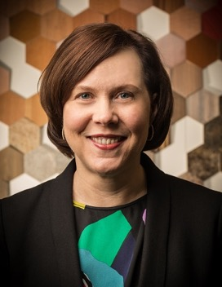
Facilitated by:
Amy Gath
Vice President, Marketing – Dan Beard Council Board of Directors
Brian Gath
Eagle Scout & Former Pack 189 CubMaster

Slide 3
Families today are bombarded with communications
According to a 2019 campaign monitor survey, the average American Family receives over 120 “messages” per day from a variety of sources
Source: Campaign Monitor 2019 “Message” Study.

Slide 4
And in that context…. How do you break through? Communications to families set the tone for your den, pack or troop

Slide 5
3 best practices for family communications
Think CUB!
C – Communicate Consistently
U – Make sure your messages are Unified
B – Keep it Brief

Slide 6
C – Communicate consistently
Establish a regular cadence for communication
Set up a consistent channel for communications
Be careful not to communicate “old news”

Slide 7
U – Make sure your messages are unified
If you’re sharing information in multiple places, make sure it is all the same!
If you’re sharing information in multiple places, link messaging back to one source of the truth
Think hard about where you post communications – maintaining multiple channels is a lot of work, and the consequences of out-of-date information can be dire

Slide 8
B – Keep it brief
The average person has an 8-second attention span.
Short and simple wins every time.
Source: Microsoft Neuroscience study, 2015.

Slide 9
3 best practices for family communications
Think CUB!
C – Communicate Consistently
U – Make sure your messages are Unified
B – Keep it Brief

Slide 10
Questions?

