Slide 1
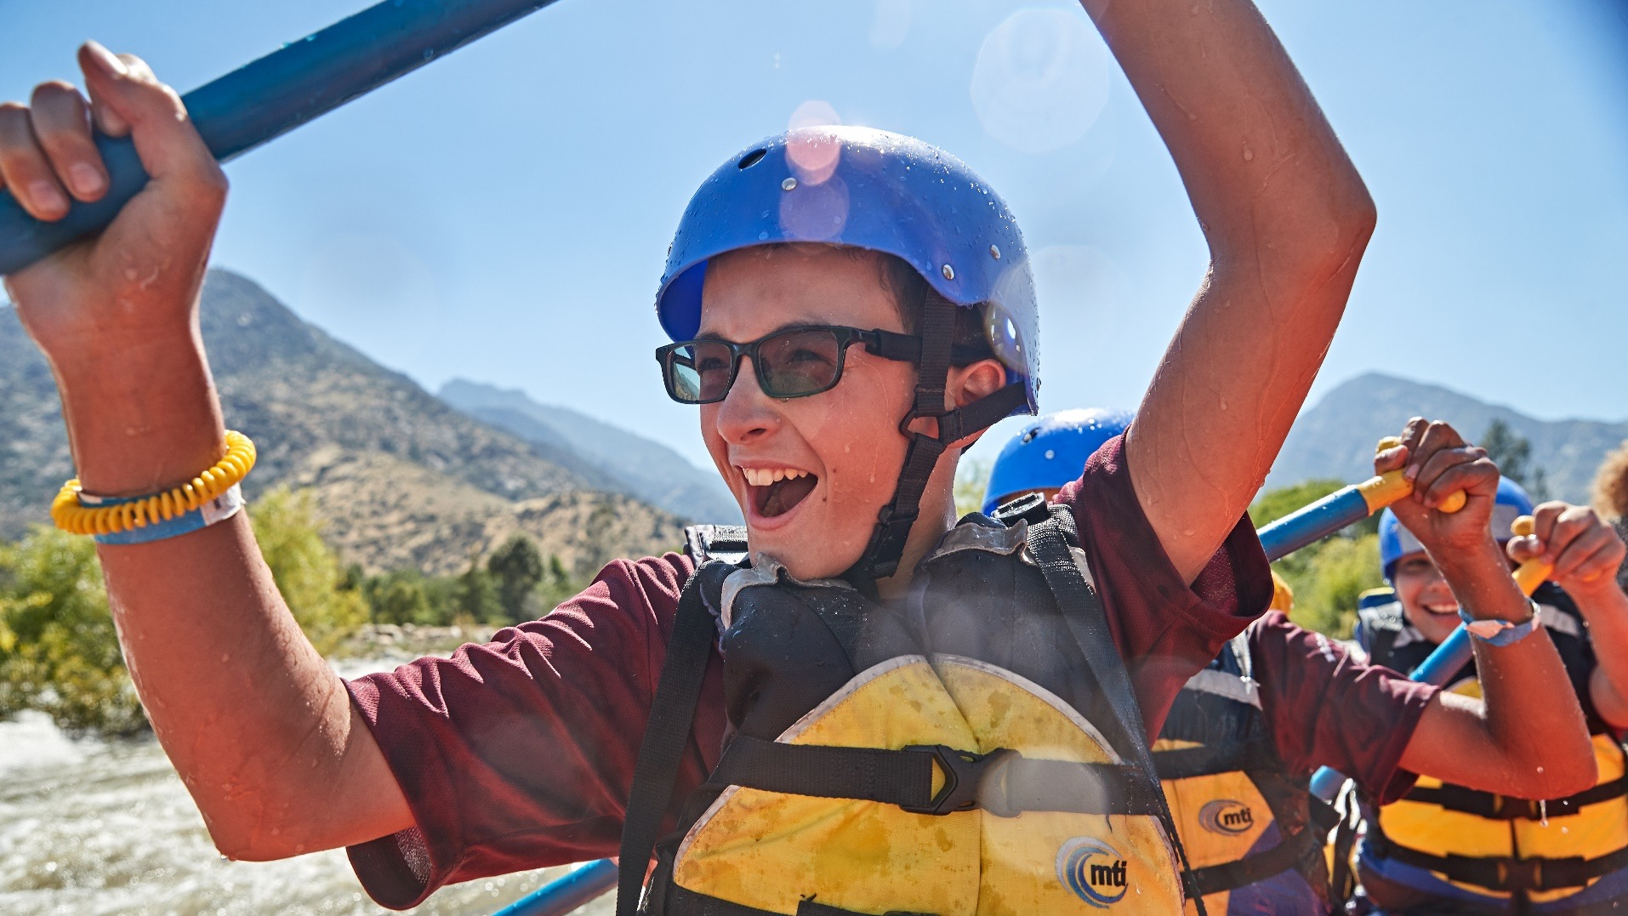

Slide 3
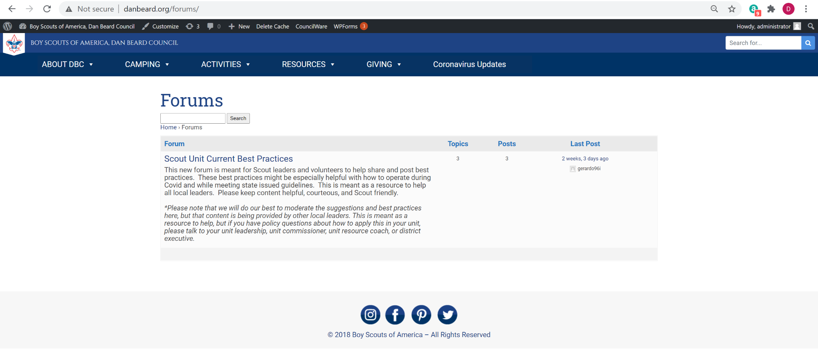

Slide 4
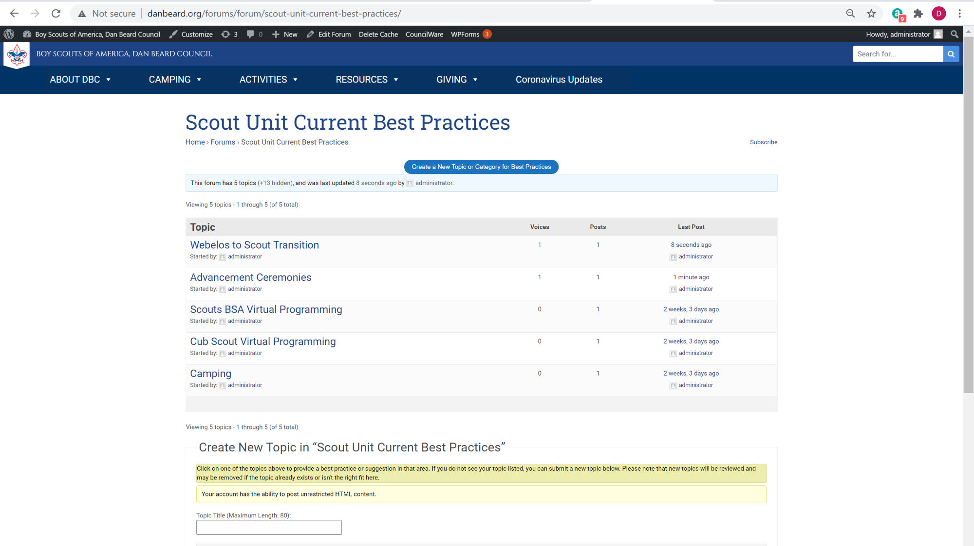

Slide 5
Camping Resources
Assistance with outdoor activities and camping are a common request
Where to Go Camping Guide
Over 100 pages of parks, camps, and trails
Abridged list of places open to Scouts right now
How to Camp zoom session
Share best practices for camping with the current restrictions
Learn how you can utilize the council camps or other facilities
January 14, 2021 at 7:00 pm; rsvp at www.danbeard.org/camping
Notes:
Bryce
Outdoor programs and camping are at the heart of Scouting. Many of our packs and troops are doing their best to get out and do something, but many have asked for help with where to go, and how to do it safely.
The Where to Go Camping Guide is an established resource available online at danbeard.org. It has over 100 pages of camps, parks, and trails that allow Scouts to participate. Many of these are closed to group camping right now due to state and local restrictions, meaning Scouts may not be able to utilize them. An abridged list of places that are open to Scouts is available on the Scouting Forward Together webpage. If your units are looking for a place to camp, hike, or do another outdoor activity, make sure to download that list.
A follow up Zoom session will be available for any units who want to participate, that will focus on tips and best practices for camping with the current guidelines and restrictions from the state and local health departments. We will discuss how units can utilize the council camps, how they can plan for small group outings, and provide a forum for sharing ideas. This will take place on January 14 at 7:00 pm on Zoom. Units can RSVP on the Scouting Forward Together webpage.

Slide 7
FUNDING UNIT TREASURY
Summer Activities
Summer Camp
Annual Dues and Registrations
Recognition & Advancement Ceremonies
Notes:
Steve: Thanks Bryce! [Introduce Yourself] So Bryce just talked about camping activities, and a little later on we’ll discuss advancement ceremonies, summer camp, and more. But all of these things have one thing in common, and that is that units and scouts need funds to help cover the cost of them. Based on the results you submitted from your last unit meetings, 51% of our units expressed interest in a Spring fundraiser! As we look to support and strengthen our units, one key way that we can help to support them is by ensuring the unit treasury has the funds it needs coming out of recharter, for upcoming summer activities, summer camp, recognition ceremonies, and everything else they have planned. With any luck, the Covid vaccine will bring activities very soon and (say emphatically) our Scouts are going to be so anxious and ready to get out and explore! Let’s make sure our units are ready to fund these adventures when that time comes.
[next slide]

Slide 8
SPRING FUNDRASING OPTIONS TO SUPPORT YOUR UNIT
Camp Cards and other additional online or in-person product sales (product still being determined)
COFFEE
PEANUTS
Notes:
So to do that, we are providing several options to support units. Many units indicated they were interested in our traditional Camp Card program that is essentially a coupon card with 1,000’s of discounts on it. I know we are planning to have the digital version of that again. And several units also expressed an interest in a product sale that would be different from popcorn in the fall - such as beef jerky, peanuts, or coffee. So we are currently putting together some options in order to provide a streamlined low-risk fundraiser that units can benefit from. [next slide]

Slide 9
FUND YOUR UNIT TREASURY SPRING FUNDRAISING INFORMATION LEARNING SESSION
Thursday, February 4th at 7pm
Units can register to attend online at:
www.danbeard.org/FundMyUnit
Notes:
And we are going to walk through all of the available options and details for units during a Spring Fundraising Information Learning Session on Thursday, February 4th at 7pm. This will be a virtual zoom meeting, and we’ll share all of the details. Units can register themselves at danbeard.org/FundMyUnit. So key item for each of you tonight. Please make sure the unit you are working with, both the unit fundraising person and unit leader, are aware of this session, and make sure they get registered especially if they previously said they might be interested in a spring fundraiser. I would even say, take a moment during your meeting with them to help get them registered online to attend so that they can be sure to see the available options and get the details. Thursday, February 4th, 7pm. Thanks everyone! And now I’ll turn it over to Melissa Ford.

Slide 11
RECOGNITION CEREMONIES (ADVANCEMENT)
Many Options Available on Resources Page
Fully Virtual
Hybrid
Drive Thru/up
Personal Delivery
Notes:
Many units have indicated they are struggling with advancement ceremonies and crossover planning. There are many ways a unit can provide recognition and “ceremonies” to their Scouts even during this time. We have added resources with ideas and best practices from our units to the resource page. The key to advancement ceremonies is to make them as immediate as possible, and as meaningful and memorable as possible.
There are 4 types of suggestions, Virtual, Hybrid, Drive thru, personal delivery. Full Blue and Gold ceremonies and Courts of Honor should be held in spring/early summer as health department regulations allow. This will allow additional opportunities to recognize Scouts in a more traditional way.

Slide 13
Webelos to Scout Transition
Membership Focus for Scouts BSA Troops
Now
Get AOL roster and DROPPED 6th graders from charter (1 year “reach-back”)
Contact your District Executive for names/contact information.
Engage with Arrow of Light Scouts/Dens
Contact AOL Den Leader/Cubmaster to coordinate crossover plans/timeline
Next
Send invitations to AOL families to visit Troop (in-person/virtual or BOTH)

Slide 15
Summer Camp Promotions
Summer Camp should be part of a units plans for this coming summer
Cub Camp Rally
January 26, 2021 at 6:30pm via Zoom; Register at www.danbeard.org/Cub-Camp-Rally
One stop for all the information a pack needs about Cub World summer camp
Every pack should have someone attend
Camp Friedlander Information Night
February 23, 2021 at 7pm via Zoom; Register at www.danbeard.org/attend-camp-friedlander-summer-camp
Learn how Camp Friedlander summer camp can support your unit program, and excite your Scouts
All troops welcome
Notes:
Summer Camp, and the activities that Scouts get to do while at camp, is the reason most Scouts join in the first place.

Slide 16
Wrap Up
Resources online at www.danbeard.org/scoutingforward
Referenced Support Materials & Links
How to Camp Zoom Info Session: January 14th at 7:00 pm – www.danbeard.org/camping
Best Practices Forum: www.danbeard.org/best-practices
Spring Fundraising Learning Session: Thursday, February 4th at 7pm - www.danbeard.org/FundMyUnit
Cub Camp Rally: January 26, 2021 at 6:30pm - www.danbeard.org/cub-camp-rally
Camp Friedlander Information Night: February 23, 2021 at 7pm - www.danbeard.org/attend-camp-friedlander-summer-camp
Notes:
Summer Camp, and the activities that Scouts get to do while at camp, is the reason most Scouts join in the first place.

