Slide 4
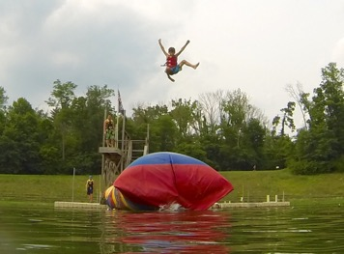
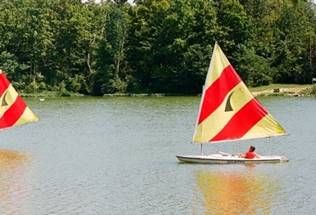
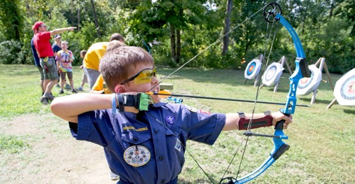
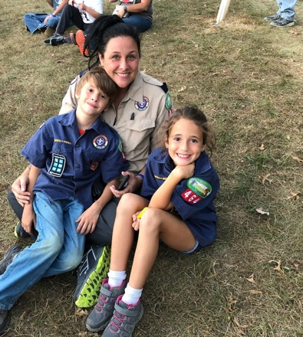
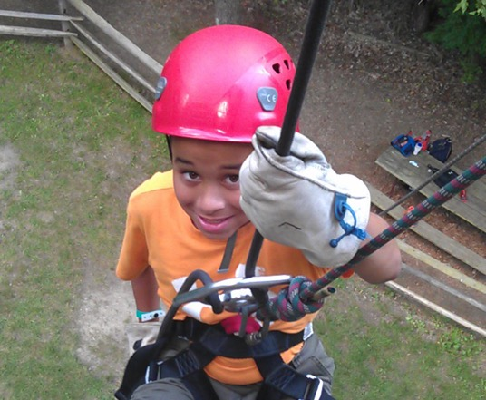
2021 PROGRAM KICKOFF
JUNE 3, 2021
6pm Virtually
WWW.DANBEARD.ORG/PROGRAM-KICKOFF
Notes:
Join us for the Dan Beard Council Program Kickoff on June 3, 2021.
This virtual event will feature everything they will need to plan a full year of programming as we transition back to a more normal year of Scouting. Our Scouts are anxious to get back outside and do all the activities they love or would love to try. The Program Kickoff will offer leaders all the information for Dan Beard Council events like summer camp, Spook-O-Ree, camporees and more. And new this year, we are inviting organizations from around the region who to participate. These organizations offer many types of Scouting activities that can fill out your program year.
We will fill out the evening with resources to help plan a calendar of activities, build a budget to fund those activities, and how to effectively communicate those activities to your families. The Program Kickoff will be held virtually, and registration will begin starting April 15th. Find out more at the link above.

Slide 5
CUB WORLD
Planned safety protocols have allowed for additional capacity
Additional camper spots will be available starting April 7
Cub World will open for weekend unit camping on April 16.
Reservations available now.
Notes:
Cub World staff has developed a robust set of safety and sanitation protocols and has been working with the Department of Health to determine the summer camp plans for Cub World Adventure Camp. While not yet complete, we are able to open some additional capacity for camp this summer.
These camper spots will allow for additional units to register and for more Scouts within a pack to come. Demand for camp has been high, and this space is needed. We recommend acting quickly to ensure your Scouts get the opportunity to camp this summer at Cub World Adventure Camp.
We are also excited to announce that Cub World is reopening for weekend camping starting April 16. Packs can begin making reservations to use camp this spring starting now.

Slide 6
SCOUTS BSA SUMMER CAMP
Planned safety protocols have allowed for additional capacity at Camp Friedlander.
Additional camper and troop spots will be available starting April 7.
Space available now in July and August weeks
Every troop should have summer camp plans for Camp Friedlander or another Scouts BSA camp.
Notes:
Camp Friedlander staff has developed a robust set of safety and sanitation protocols and has been working with the Department of Health to determine the summer camp plans. While not yet complete, we are able to open some additional capacity for camp this summer. While we have space for more units right now in some of our later weeks. We will be able to open some additional spaces starting April 7.
While we believe that Camp Friedlander should be a part of every troop’s rotation, we know that not every troop will attend Camp Friedlander every year. However, it is important that every troop has plans for summer camp this year. We are still hearing that several units are not quite yet signed up for camp. If that applies to any of your troops, please reach out to the program team at Dan Beard Council or your District Executive so we can help get you signed up.

Slide 8
APRIL PRIORITIES
Ensure every pack and troop receives a visit
Promote Program Kickoff to be held June 3
Promote summer camp programs at Cub World Adventure Camp and Camp Friedlander
Every unit should have plans for a summer camping activity

Slide 9
Next Meeting: Monday, May 3, 2021
RSVP at www.danbeard.org/unit-resource-coach

Slide 10
DISTRICT BREAKOUTS

